Slide 1

Basic Details of the Team and Problem Statement
Ministry/Organization Name/Student Innovation: Department of Empowerment of Persons with Disabilities(Divyangjan) , Ministry of Social Justice and Empowerment
PS Code:RK775
Problem Statement Title:
Software for facilitation of various Govt. schemes for persons with disabilities.
Team Name: CSPIT Arise
Team Leader Name: Raj Dave (D21IT170)
Institute Code: C-16183
Institute Name: Chandubhai S Patel Institute Of Technology
Theme Name: MedTEch/ BioTech/ HealthTech

Slide 2
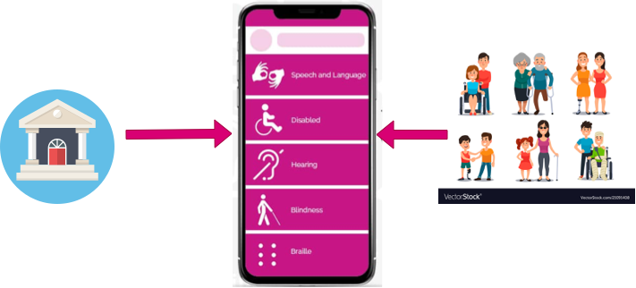
Idea/Approach Details
Government
Disabled People & Caregivers
Describe your idea/Solution/Prototype here:
An application that will help disabled people to get aware of the Govt. schemes available for them
App will Broadcast a Various Govt. schemes
Will Try to Implement W3C Web Accessibility Initiative (WAI) Standards To Our App, Such as…..
Simple to Use & highly Accessible UI Design for Disabled & Caregivers
care of color contrast for low contrast sensitive peoples
more than one language support
audio support 🔉
visual instruction 👀using various animation and videos
Large Buttons & Control
Describe your Technology stack here:
Frontend: Flutter & Dart
Backend: Firebase

Slide 3
Idea/Approach Details
Describe your Use Cases here
Describe your Dependencies / Show stopper here
All schemes at single Place
Useful links and contacts (if available) and instructions Will be available, so that they can avail the benefits easily.
various categories of schemes based on the different disabilities.
Examples: Schemes for Visual Blind People, Schemes for People who can’t hear.
Useful for all kind of disable peoples
Understandable Content
with the help of Multi-Language Support & Text To Speech Support
There are many ADIP, DDRS and many other schemes are available for the disabled people
But this all information is not known to everyone, so our application will help every phone user to be aware of this all information.
Govt. websites that provides the information about the schemes available for the disabled peoples

Slide 4
Team Member Details
Team Leader Name: Raj Dave
Branch (Btech/Mtech/PhD etc):Btech Stream (IT): IT Year (I,II,III,IV): |||
Team Member 1 Name: Raj Bapodra
Branch (Btech/Mtech/PhD etc):Btech Stream (IT): IT Year (I,II,III,IV): |||
Team Member 2 Name: Mansi Chaniyara
Branch (Btech/Mtech/PhD etc):Btech Stream (IT): IT Year (I,II,III,IV): |||
Team Member 3 Name: Abhishek Galfade
Branch (Btech/Mtech/PhD etc):Btech Stream (IT): IT Year (I,II,III,IV): |||
Team Member 4 Name: Dhaval Visariya
Branch (Btech/Mtech/PhD etc):Btech Stream (IT): IT Year (I,II,III,IV): |||
Team Member 5 Name: Karan Chauhana
Branch (Btech/Mtech/PhD etc):Btech Stream (IT): IT Year (I,II,III,IV): |||
Team Mentor 1 Name: Purvi Prajapati
Category (Academic/Industry): Academic Expertise (AI/ML/Blockchain etc): ML Domain Experience: 15 years (teaching)

